Slide 1

Nations Switch
Instructor: Professor Jia Zhang Team 7 – Giancarlo Rinaldini, Chenqi Zhang
<Service Oriented Software Engineering> (CS 7340), Fall2021

Slide 2
Roadmap
Introduction
Motivation
Related work
Design
System implementation
Demo
Conclusions and future work

Slide 3
Introduce
“Nation Switch”—— A web application.
Dynamically display the national flag and other detailed information of the country.
Dynamically mark every country which user has chosen on the map according to its geographical location.
Provides an interface linked to translation webpage.

Slide 4
Motivation
Countless scientific, technological and cultural progresses which are contributed by people's cross-national cooperation and communication.
Help people from all over the work to easily access the information of different countries
Make preparations for further cooperation in the future

Slide 5
Related work
Target the tourism audience that will visit Wikipedia pages and news outlets to learn about travel stops.
Have an efficient method of accumulating important travel data such as currency, language, geographical location and quick access to google translate.

Slide 6
Design
Quick login page:
Preview of earth map.
Go button.
Country details page:
The map with country markers.
Flag and detailed information of country.
Scroll down list contained all of countries.
Translate button

Slide 7
System implementation
Update the Play framework from 2.7.3 to 2.8.0.
Update the code to adapt the new version of Play according to the Play Migration Guide.
Create our new login.html and create Mashup for Map API Leaflet.
Create the main page of our web app and create Mashup for Map Leaflet API and REST Countries API separately.
Update the routes file, action function of buttons and scroll down menu in the web page

Slide 8
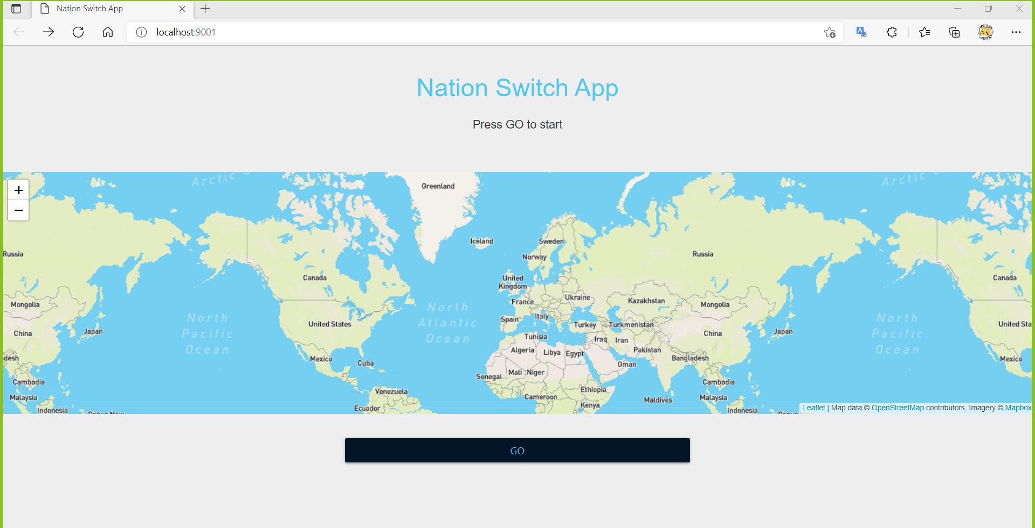
Demo
From the first quick start page, user can just click GO button to further browse our web.

Slide 9
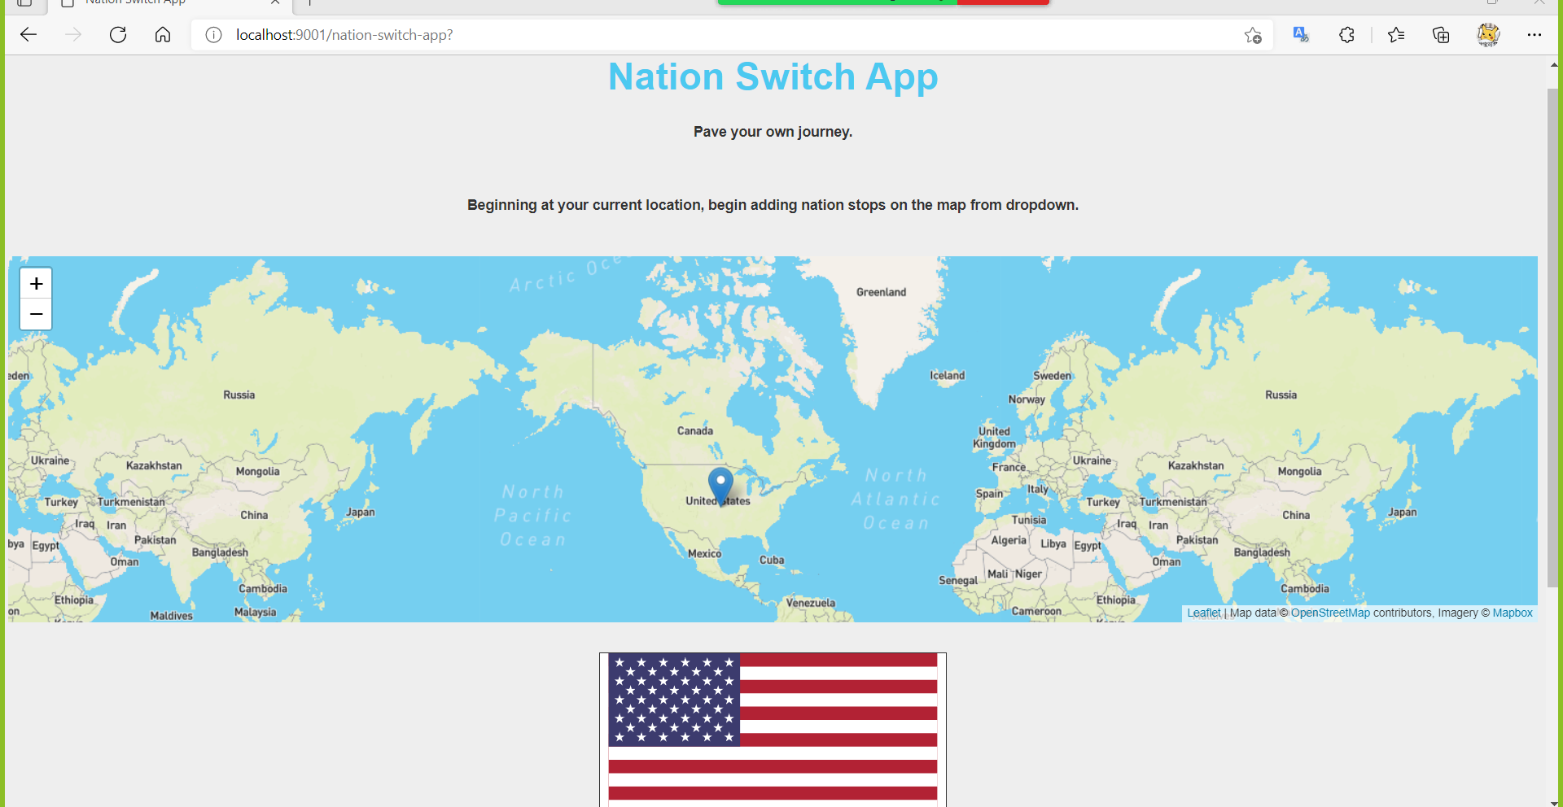
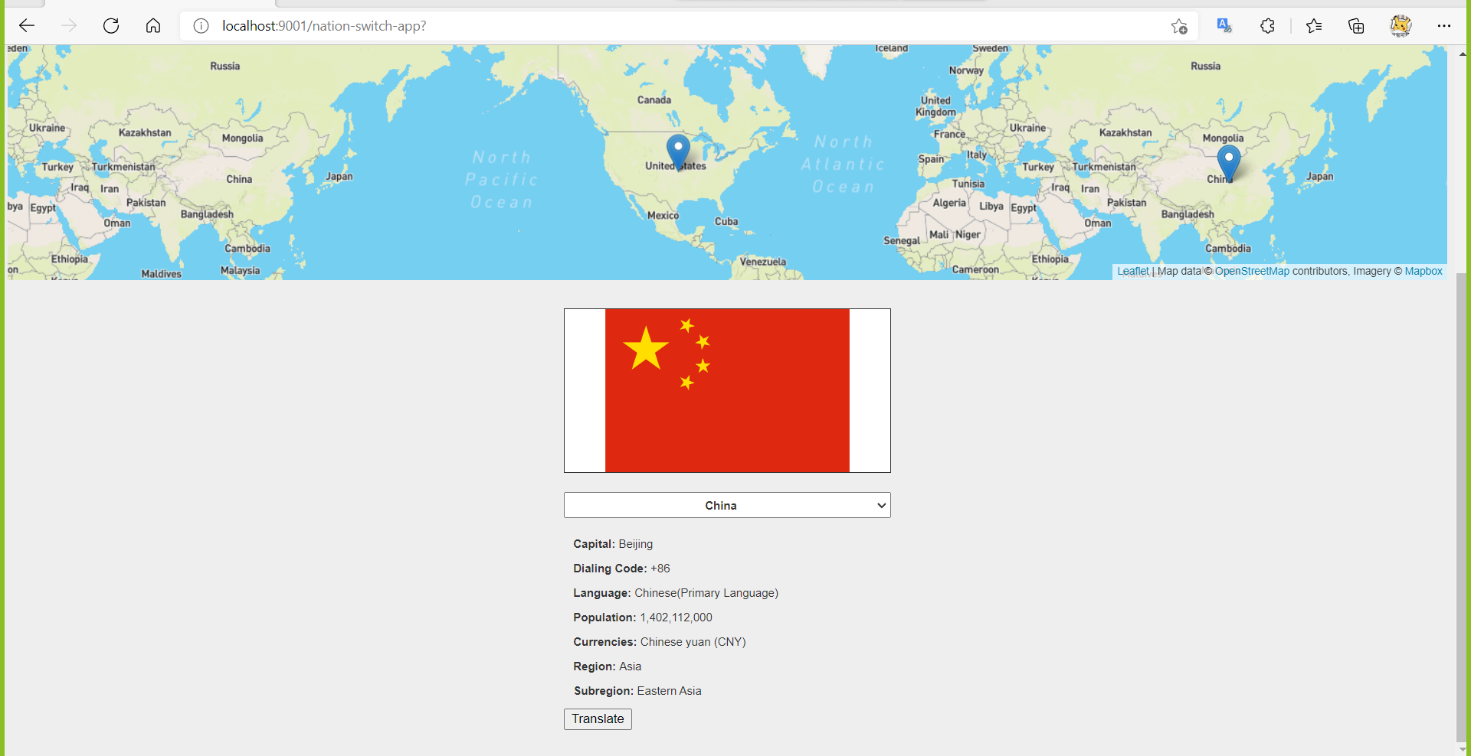
Demo
In the second page, user can browse the detailed information of selected countries and the locations of those countries.
User can always select new countries. The markers on the map and detail information will be dynamically updated.
User also can click Translate button to know some basic local language.

Slide 10
Conclusions and future work
Conclusions:
Our web app is easy to access and contain meaningful functionality. We hope this Nations Switch app will become a useful tool for people who love to get to know other countries and communicate with their people.
Future work:
Try to add real-time weather information of main cities.
Try to add pictures of landmark buildings of the country.
Try to further optimize the user interface.

Slide 11

Questions?

